Slide 1
chapter 12
More on Classes

Slide 2
The three OOP factors
Remember, we said there were 3 factors that distinguished an Object Oriented Programming language:
encapsulation
inheritance
polymorphism

Slide 3
We are still at encapsulation
We said that encapsulation:
hid details of the implementation so that the program was easier to read and write
modularity, make an object so that it can be reused in other contexts
providing an interface (the methods) that are the approved way to deal with the class

Slide 4
One more aspect
A new aspect we should have is consistency
Remember Rule 9: Do the right thing
A new class should be consistent with the rules of the language.
It should respond to standard messages, it should behave properly with typical functions (assuming the type allows that kind of call).

Slide 5
An example
Consider a Rational number class. It should respond to:
construction
printing
arithmetic ops (+, -, *, /)
comparison ops (<, >, <=, >=)

Slide 6
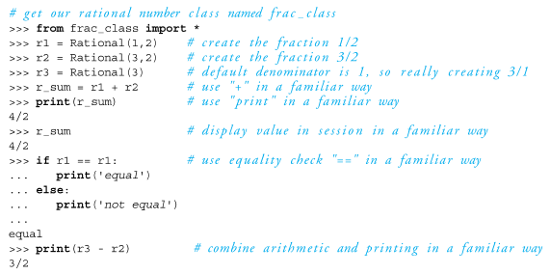
example program

Slide 7
just like any other number
by building the class properly, we can make a new instance of Rational look like any other number syntactically.
the instance responds to all the normal function calls
because it is properly encapsulated, it is much easier to use

Slide 8
But how can that work?
Two parts:
Python can distinguish which operator to use based on types
Python provides more standard methods that represent the action of standard functions in the language
by defining them in our class, Python will call them in the "right way"

Slide 9
More on type
As we have mentioned, a class is essentially a new type
when we make an instance of a class, we have made an object of a particular type
1.36 is a float
my_instance = MyClass(), my_instance is a type MyClass

Slide 10
Introspection
Python does not have a type associated with any variable, since each variable is allowed to reference any object
however, we can query any variable as to what type it presently references
this is often called introspection. That is, while the program is running we can determine the type a variable references

Slide 11
Python introspection ops
type(variable) returns its type as an object
isinstance(variable,type) returns a boolean indicating if the variable is of that type

Slide 12
Code Listing 12.1

Slide 13
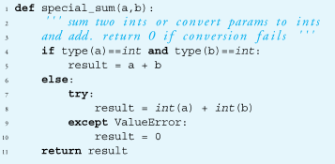

Slide 14
Operator Overloading
(Yfirskrift virkja)

Slide 15
So what does var1+var2 mean?
The answer:
it depends
What it depends on is the type. The + operation has two operands. What are their types?
Python uses introspection to find the type and then select the correct operator

Slide 16
We've seen this before
What does var1+var2 do?
with two strings, we get concatenation
with two integers, we get addition
with an integer and a string we get:
Traceback (most recent call last):
File "<pyshell#9>", line 1, in <module>
1+'a'
TypeError: unsupported operand type(s) for +: 'int' and 'str'

Slide 17
Operator overloading
the plus operator is overloaded(yfirskrifaður)
that is, the operator can do/mean different things (have multiple/overloaded meanings) depending on the types involved
if python does not recognise the operation and that combination of types, you get an error

Slide 18
Python overload ops
Python provides a set of operators that can be overloaded. You can't overload all the operators, but you can many
Like all the special class operations, they use the two underlines before and after They come in three general classes:
numeric type operations (+,-,<,>,print etc.)
container operations ([ ], iterate,len, etc.)
general operations (printing, construction)

Slide 19
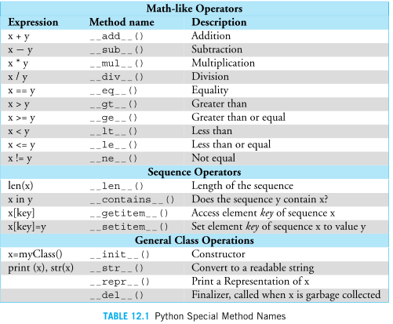

Slide 20
Code Listing 12.2

Slide 21
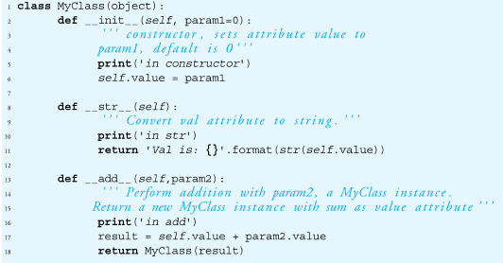

Slide 22
how does v1+v2 map to __add__
v1 + v2
is turned, by Python, into
v1.__add__(v2)
These are exactly equivalent expressions. It means that the first variable calls the __add__ method with the second variable passed as an argument
v1 is bound to self, v2 bound to param2

Slide 23
Calling __str__
When does the __str__ method get called? Whenever a string representation of the instance is required:
directly, by saying str(my_instance)
indirectly, calling print(my_instance)

Slide 24
Code Listing 12.3

Slide 25
Simple Rational Number class
a Rational is represented by two integers, the numerator and the denominator
we can apply many of the numeric operators to Rational

Slide 26
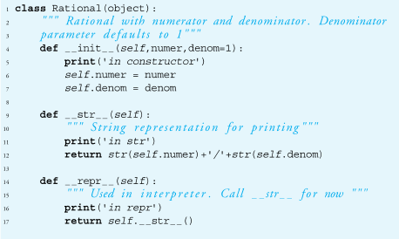

Slide 27
__str__ vs __repr__
__repr__ is what the interpreter will call when you type an instance
potentially, the representation of the instance, something you can recreate an instance from.
__str__ is a conversion of the instance to a string.
Often we define __str__, have __repr__ call __str__
note the call: self.__str__()

Slide 28
the __init__ method
each instance gets an attribute numer and denom to represent the numerator and denominator of that instance's values

Slide 29
provide addition
Remember how we add fractions:
if the denominator is the same, add the numerators
if not, find a new common denominator that each denominator divides without remainder.
modify the numerators and add

Slide 30
the lcm and gcd
the least common multiple (lcm) finds the smallest number that each denominator divides without remainder
the greatest common divisor (gcd) finds the largest number two numbers can divide into without remainder

Slide 31

LCM in terms of GCD
OK, how to find the gcd then?

Slide 32
GCD and Euclid
One of the earliest algorithms recorded was the GCD by Euclid in his book Elements around 300 B.C.
He originally defined it in terms of geometry but the result is the same

Slide 33
Code Listing 12.4-12.6

Slide 34
The Algorithm
GCD(a,b)
If one of the numbers is 0, return the other and halt
Otherwise, find the integer remainder of the larger number divided by the smaller number
Reapply GCD(a,b) with a ← smaller and b← the remainder from step 2)

Slide 35
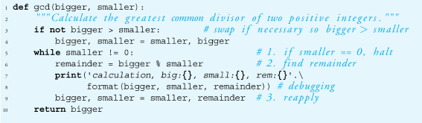


Slide 36

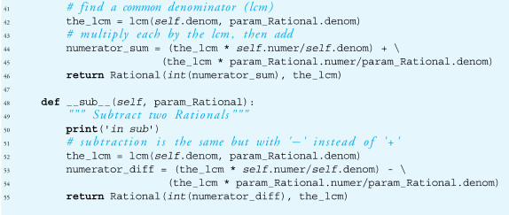
Just the add, from Code Listing 12.6

Slide 37
Equality
The equality method is __eq__
It is invoked with the == operator
½ == ½ is equivalent to ½.__eq__(½)
It should be able to deal with non-reduced fractions:
½ == ½ is True
so is 2/4 == 3/6

Slide 38
Code Listing 12.7

Slide 39
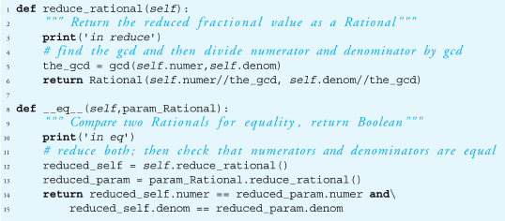

Slide 40
Fitting in
What is amazing about the traces of these methods is how many of them are called in service of the overall goal.
All we did was provide the basic pieces and Python orchestrates how they all fit together!
Rule 9 rules!

Slide 41
What doesn't work

Slide 42
So r1+r2, but what about
We said the add we defined would work for two rationals, but what about?
r1 + 1 # Rational plus an integer
1 + r1 # commutativity
Neither works right now. How to fix?

Slide 43
r1 + 1
What's the problem?
add expects another rational number as the second argument.
Python used to have a coercion operator, but that is deprecated
coerce: force conversion to another type
deprecate: 'disapproval', an approach that is no longer supported
Our constructor would support conversion of an int to a Rational, how/where to do this?

Slide 44
Introspection in __add__
the add operator is going to have to check the types of the parameter and then decide what should be done
if the type is an integer, convert it. If it is a Rational, do what we did before. Anything else that is to be allowed needs to be checked

Slide 45
Code Listing 12.8

Slide 46
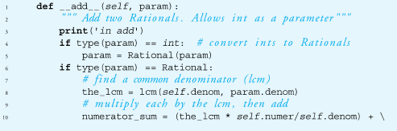
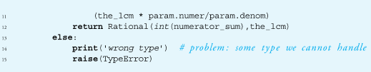

Slide 47
what about 1 + r1
What's the problem
mapping is wrong
1 + r1 maps to 1.__add__(r1)
no such method for integers (and besides, it would be a real pain to have to add a new method to every type we want to include)
user should expect that this should work. Addition is commutative!

Slide 48
radd method
Python allows the definition of an __radd__ method
The __radd__ method is called when the __add__ method fails because of a type mismatch
__radd__ reverses the two arguments in the call

Slide 49
__radd__ vs __add__
1 + r1
try 1.__add__(r1), failure
look for an __radd__ if it exists, remap
1 + r1
r1.__radd__(1)

Slide 50
radd
essentially, all we need __radd__ to do is remap the parameters.
after that, it is just add all over again, so we call __add__ directly
means we only have to maintain __add__ if any changes are required
def __radd__(self,f):
return self.__add__(f)

Slide 51
Inheritance(Erfðir)

Slide 52
Class-Instance relations
Remember the relationship between a class and its instances
a class can have many instances, each made initially from the constructor of the class
the methods an instance can call are initially shared by all instances of a class

Slide 53
Class-Class relations
Classes can also have a separate relationship with other classes
the relationships forms a hierarchy
hierarchy: A body of persons or things ranked in grades, orders or classes, one above another

Slide 54
computer science 'trees'
the hierarchy forms what is called a tree in computer science. Odd 'tree' though
root
left
right
leaf1
leaf2
leaf3
leaf4

Slide 55
Classes related by a hierarchy
when we create a class, which is itself another object, we can state how it is related to other classes
the relationship we can indicate is the class that is 'above' it in the hierarchy

Slide 56
class statement
name of the class above
this class in the hierarchy
class MyClass (SuperClass):
pass
The top class in Python is called object.
it is predefined by Python, always exists
use object when you have no superclass

Slide 57
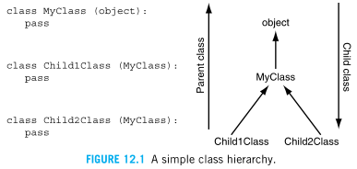

Slide 58
Code Listing 12.10

Slide 59
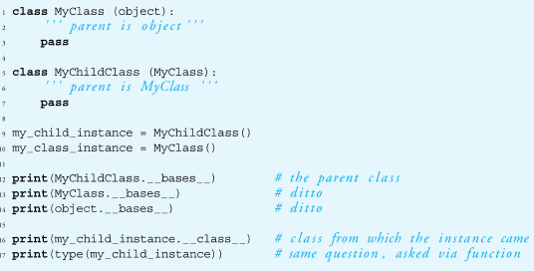

Slide 60
is-a, super and sub class
the class hierarchy imposes an is-a relationship between classes
MyChildClass is-a (or is a kind of) MyClass
MyClass is-a (or is a kind of) object
object has as a subclass MyClass
MyChildClass has as a superclass MyClass

Slide 61
um, so what?
the hope of such an arrangement is the saving/re-use of code
superclass code contains general code that is applicable to many subclasses
subclass uses superclass code (via sharing) but specializes code for itself when necessary

Slide 62
Scope for objects, the full story
Look in the object for the attribute
If not in the object, look to the object's class for the attribute
If not in the object's class, look up the hierarchy of that class for the attribute
If you hit object, then the attribute does not exist

Slide 63
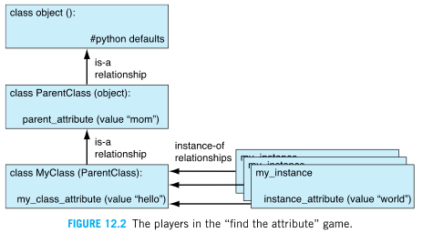

Slide 64
Inheritance is powerful but also can be complicated
many powerful aspects of OOP are revealed through uses of inheritance
However, some of that is a bit detailed and hard to work with. Definitely worth checking out but a bit beyond us and our first class

Slide 65
The Standard Model

Slide 66
builtins are objects too
One nice way, easy way, to use inheritance is to note that all the builtin types are objects also
thus you can inherit the properties of builtin types then modify how they get used in your subclass
you can also use any of the types you pull in as modules

Slide 67
specializing a method
One technical detail. Normal method calls are called bound methods. Bound methods have an instance in front of the method call and automatically pass self
my_inst = MyClass()
my_inst.method(arg1,arg2)
my_inst is an instance, so the method is bound

Slide 68
unbound methods
it is also possible to call a method without Python binding self. In that case, the user has to do it.
unbound methods are called as part of the class but self passed by the user
my_inst = MyClass()
MyClass.method(my_inst, arg2, arg3)
self is passed explicitly (my_inst here)!

Slide 69
Why???
Consider an example. We want to specialize a new class as a subclass of list.
class MyClass(list):
easy enough, but we want to make sure that we get our new class instances initialized the way they are supposed to, by calling __init__ of the super class

Slide 70
Why call the super class init?
If we don't explicitly say so, our class may inherit stuff from the super class, but we must make sure we call it in the proper context. For example, our __init__ would be:
def __init__(self):
list.__init__(self)
# do anything else special to MyClass

Slide 71
explicit calls to the super
we explicitly call the super class constructor using an unbound method (why not a bound method????)
then, after it completes we can do anything special for our new class
We specialize the new class but inherit most of the work from the super. Very clever!

Slide 72
Gives us a way to organize code
specialization. A subclass can inherit code from its superclass, but modify anything that is particular to that subclass
over-ride. change a behavior to be specific to a subclass
reuse-code. Use code from other classes (without rewriting) to get behavior in our class.

Slide 73
Reminder, rules so far
Think before you program!
A program is a human-readable essay on problem solving that also happens to execute on a computer.
The best way to imporve your programming and problem solving skills is to practice!
A foolish consistency is the hobgoblin of little minds
Test your code, often and thoroughly
If it was hard to write, it is probably hard to read. Add a comment.
All input is evil, unless proven otherwise.
A function should do one thing.
Make sure your class does the right thing.

